Slide 1


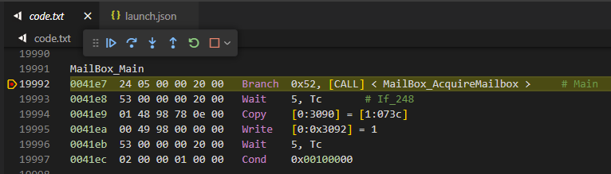

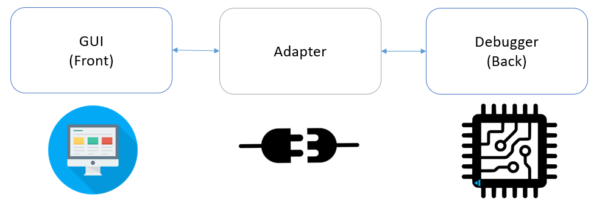
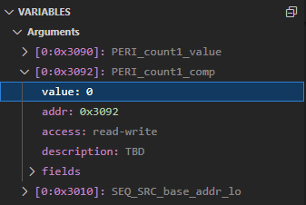


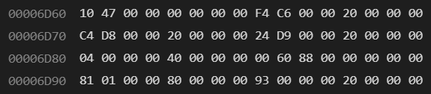
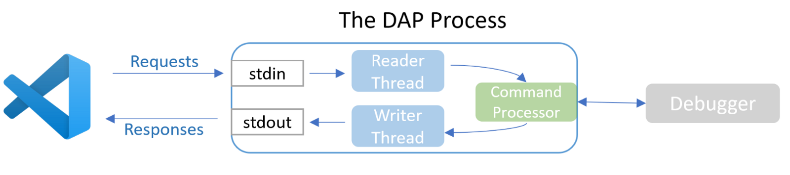
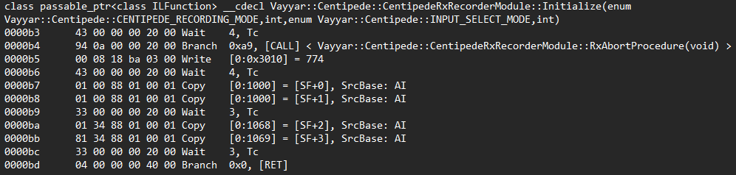
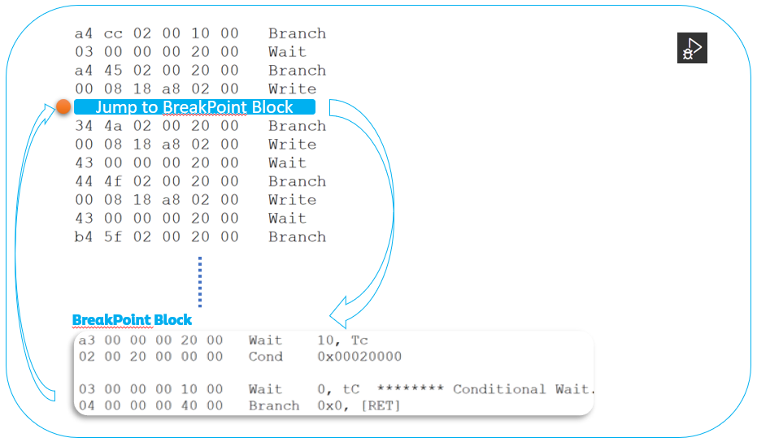
Sequencer Debugger
Low-level at your fingerprints
Project Number: 22-1-2-2659
Names: Dor Golfaiz
Advisor: Michal Carmeli
Introduction What is the Sequencer? A controller in the chip whose purpose is to control a basic flow of measurement: scanning over bands, transmitting, turning on/off modules at specific times, etc. Its purpose is to release the external CPU from real-time operations and release the real-time requirements from the external CPU. (e.g., 4 minutes vs 100 ms) Sequencer Compiler The sequencer has a compiler that was written by Vayyar, that gets as an input a recording strategy (chirp/steps, freq range, psk steps, etc.). The compiler’s output consists of two files – a binary sequencer code, and a readable text file that shows the series of opcodes and their meanings Motivation Is the text file helpful? Currently, the text file is used to quickly glimpse whether the sequencer does what it is expected to do in certain parts of the recording flow. The sequencer code is difficult to understand since a lot of optimizations take part during the compilation stage; therefore, finding bugs in its flow is almost impossible! | The solution to this issue – A Sequencer Debugger. A tool, that given the sequencer code’s text file, enables: adding breakpoints to a sequencer code stepping in and out of functions reading and writing local variables interacting with the call stack adding watchers, etc. all that while using the text file as a “precompiled” version of the code, just like in c/cpp/other compiled languages. Implementation The debugger is made of three components: GUI The debugger was developed as an extension to VSCode, s.t. the convenient and intuitive VSCode debugging interface is used to debug the sequencer code. Adapter + Debugger The Adapter – translates the message sent by VSCode to a request that the debugger can handle (for example adding a breakpoint / changing a register’s value) The Debugger – implements the request (in runtime!) on the sequencer’s IRAM, using a “breakpoint loop”: | Results The debugger as a VSCode extension The debugger is currently operational and allows company employees to debug Sequencer code and get a hold on different variables that weren’t reachable before, for example, finding the VCO and capacitor chosen on the algorithmic flow to lock the PLL on a specific frequency. An example of debugging a sequencer code, directly on a chip, using the extension: Conclusions The Sequencer Debugger has already been put to use in multiple bugs and issues - and it even helped identify the source of an urgent bug that was spotted by one of Vayyar’s clients. It helped fill a key aspect of compiled languages – the ability to debug the code, without the use of simulators. Currently, in addition to the basic features stated in the “Motivation” section, the extension also – Supports all versions of the chip provided by the company (Centipede A, B, and C). Provides syntax highlighting. Creates a generic launch configuration that can be edited based on the device, Vayyar’s API versions, running program (text file), etc.
An example of a sequencer program(in Hexadecimal)
An example of a sequencer text file

